Slide 1


Slide 2


Electrochemical Impedance
Spectroscopy (EIS)
ECS Edition
Jonathan Halter

Slide 3

1 000 000
500 000
250 000
125 000
64 000
32 000
16 000
8 000
4 000
2 000
1 000
500
300
200
100
Correct Answer !
In which of these fields is EIS
NOT commonly used
A. Corrosion Studies
B. Fuel Cells
C. Batteries
D. Combustion
Engines
D. Combustion
Engines

Slide 4
1 000 000
500 000
250 000
125 000
64 000
32 000
16 000
8 000
4 000
2 000
1 000
500
300
200
100
Correct Answer !
According to Ohms Law,
the resistance is the ratio of what
A. Voltage to Power
B. Power to Current
C. Voltage to Current
C. Voltage to Current
D. Current to Voltage

Slide 5
1 000 000
500 000
250 000
125 000
64 000
32 000
16 000
8 000
4 000
2 000
1 000
500
300
200
100
Correct Answer !
For which circuit element is Ohms law valid ?
A. Capacitor
B. Warburg element
C. Resistor
C. Resistor
D. Inductance

Slide 6
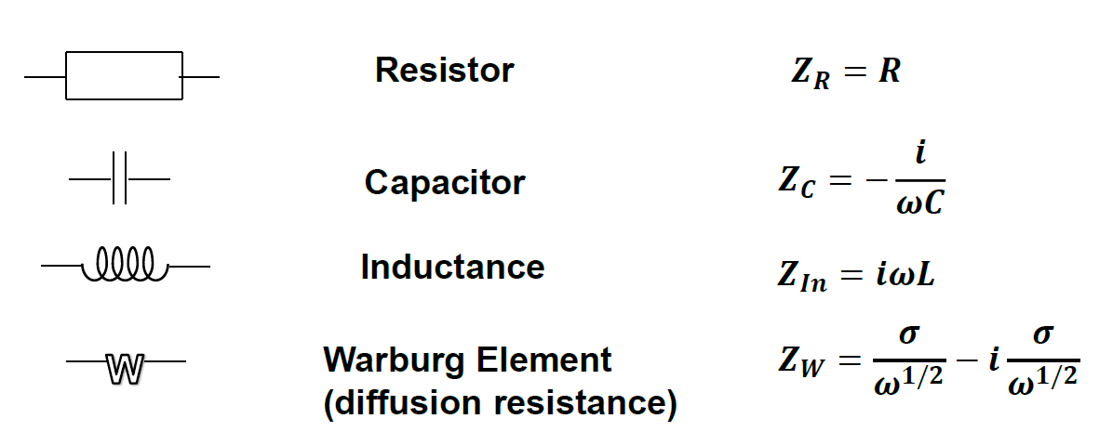
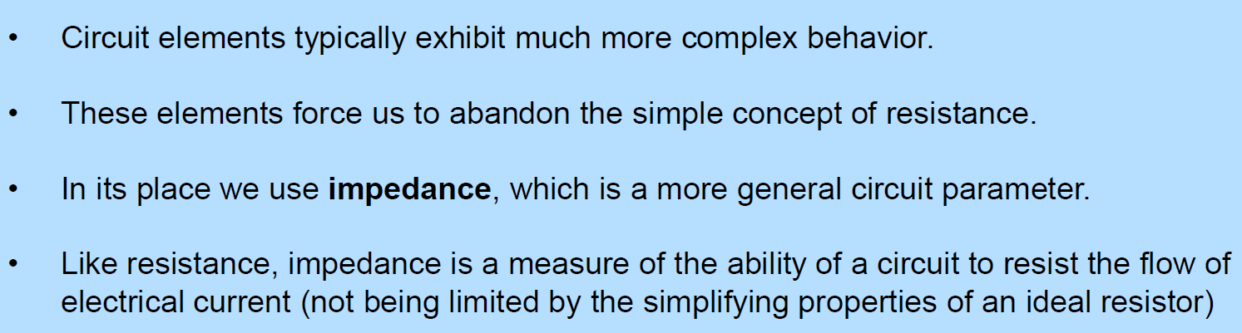
Circuit Elements Add-On

Slide 7
1 000 000
500 000
250 000
125 000
64 000
32 000
16 000
8 000
4 000
2 000
1 000
500
300
200
100
Correct Answer !
EIS is commonly measured by applying a?
A. DC potential and
measuring DC current
B. AC potential and
measuring AC current
B. AC potential and
measuring AC current
C. DC current and
measuring AC potential
D. AC current and
measuring DC potential

Slide 8
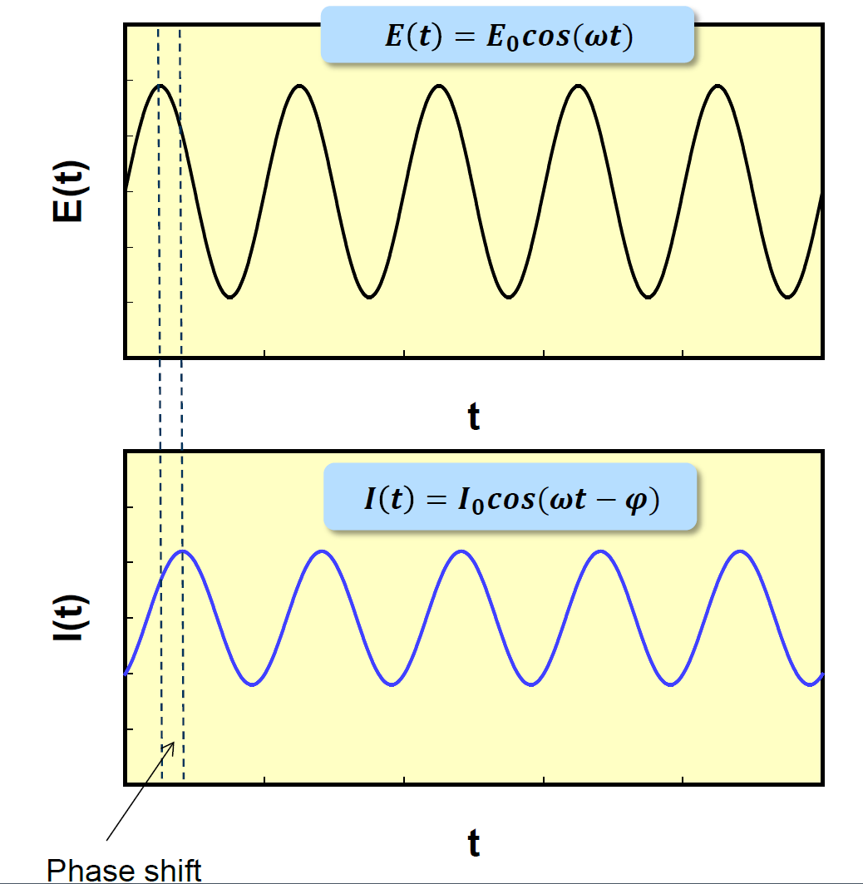
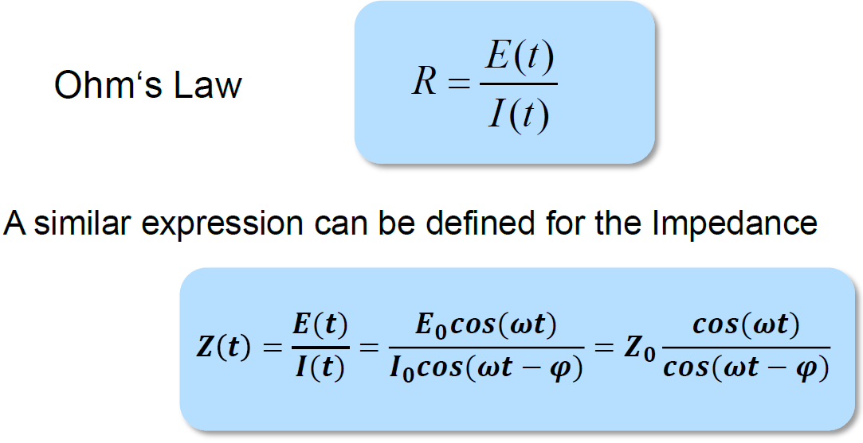
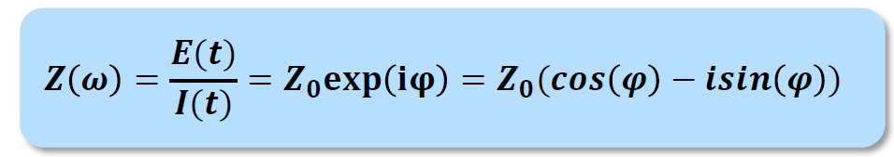
EIS Add-On

Slide 9
1 000 000
500 000
250 000
125 000
64 000
32 000
16 000
8 000
4 000
2 000
1 000
500
300
200
100
Correct Answer !
How are to axis labeled in a Nyquist Plot
[x-axis/y-axis]
A. [-Re(Z)/Im(Z)]
B. [-Re(Z)/-Im(Z)]
C. [Re(Z)/-Im(Z)]
C. [Re(Z)/-Im(Z)]
D. [Re(Z)/Intensity)]

Slide 10
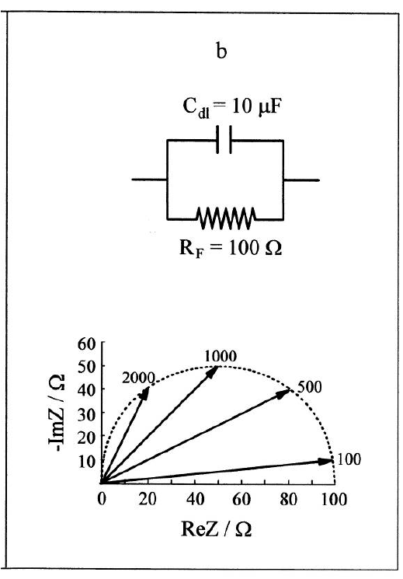
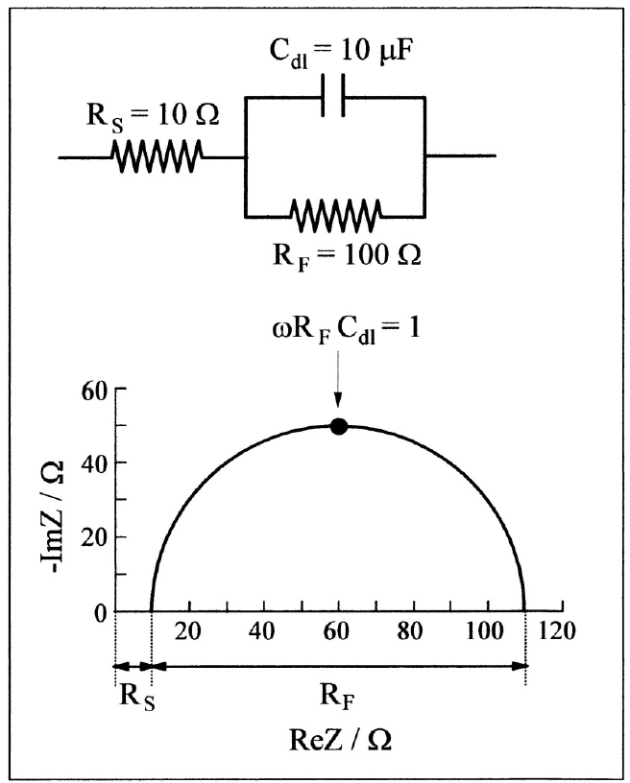
Nyquist Plot add-on

Slide 11
YOU ARE READY FOR THE EXAM
ECS Edition
Jonathan Halter

